Slide 1

Lesson 04: Error Propagation and Handling

Slide 2
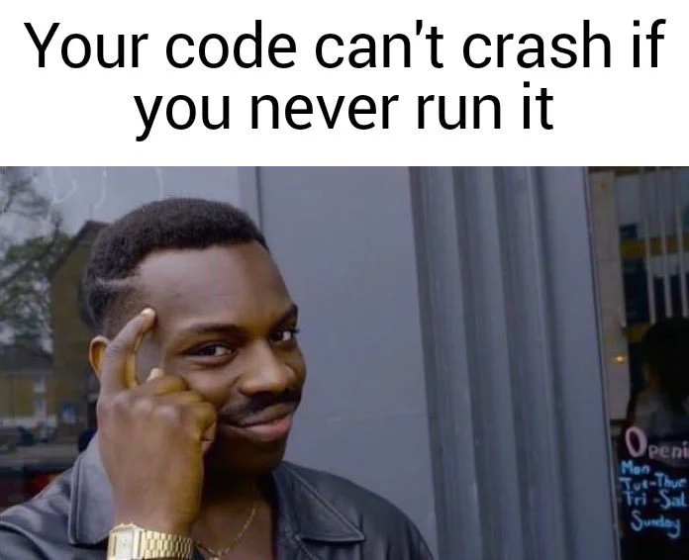

Slide 3

Lesson plan:
Exceptions
Checked
Unchecked
Try. Catch. Finally.
Default exception handler
Assertions
Q&A

Slide 4
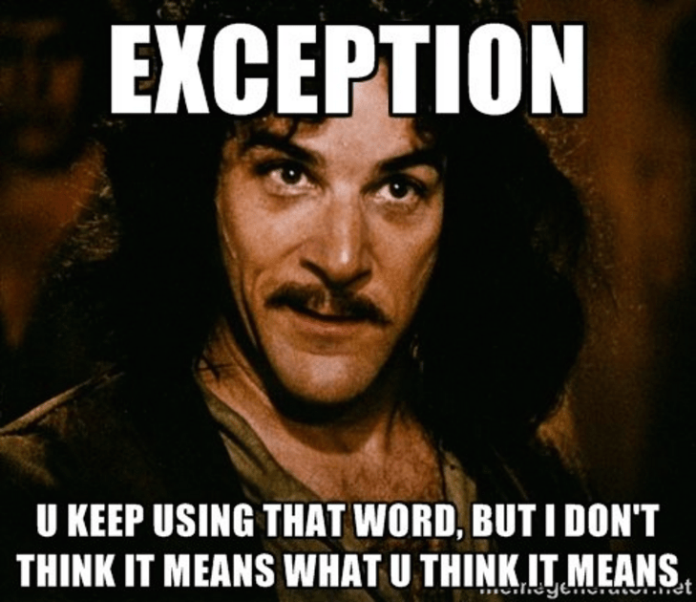

Slide 5
What is exceptions?
“An exception is an event that occurs during the execution of a program that disrupts the normal flow of the program's instructions..”
@JavaPoint

Slide 6
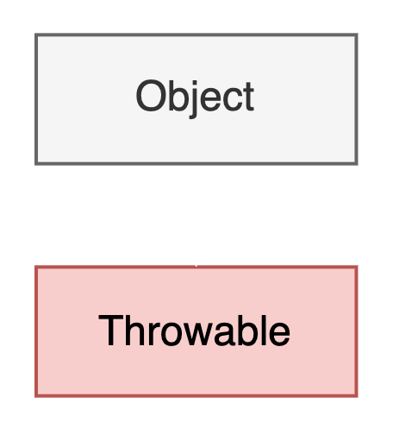
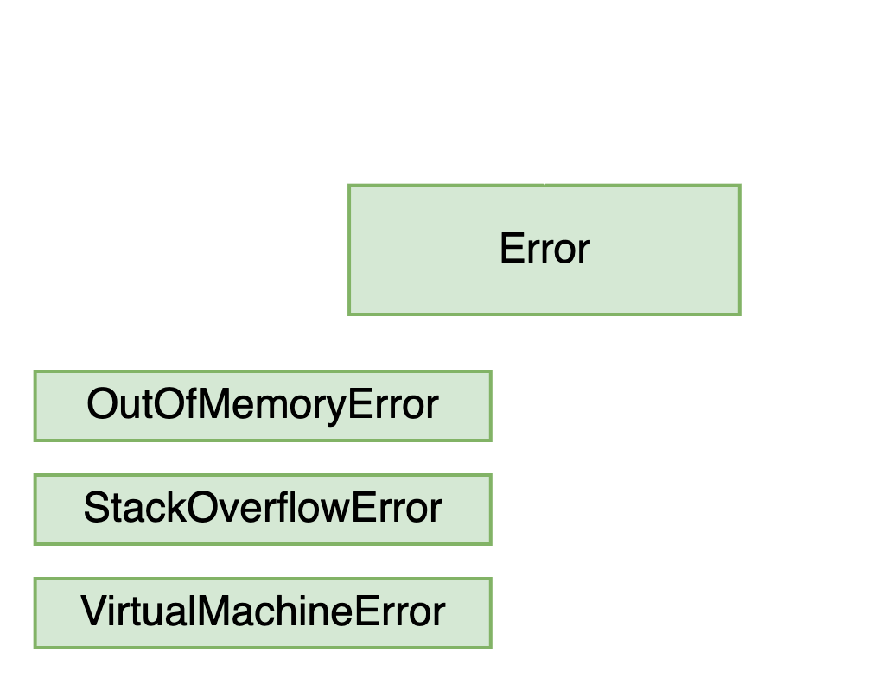
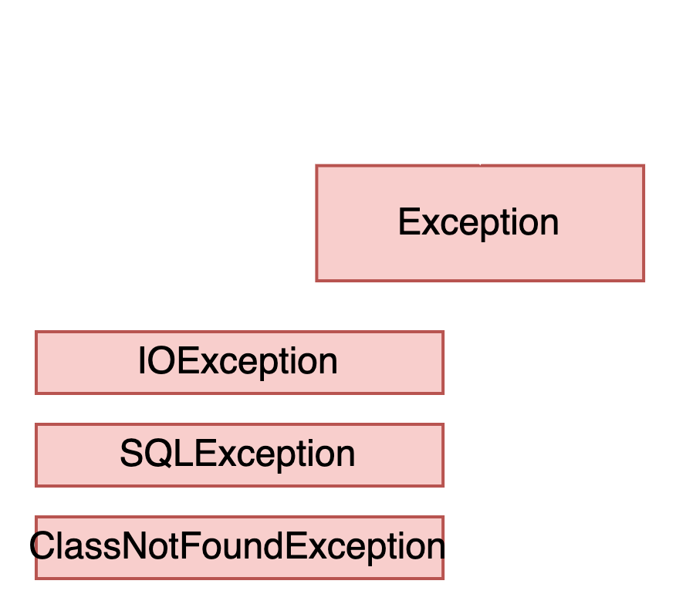
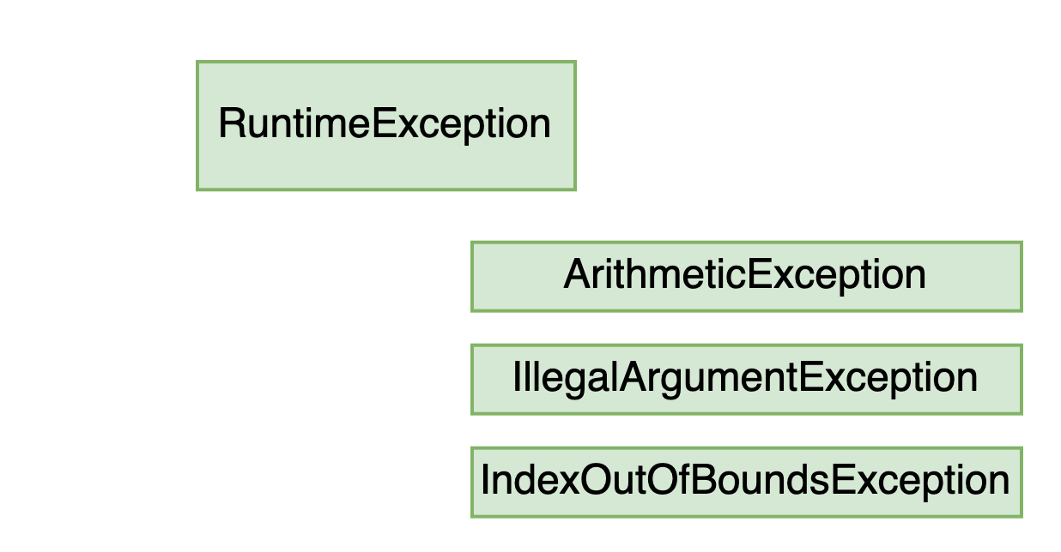
Types of exceptions
The Throwable class is the superclass of all errors and exceptions in the Java language
An exception is an event that occurs during the execution of a program that disrupts the normal flow of the program's instructions.
An Error is a subclass of Throwable that indicates serious problems that a reasonable application should not try to catch. Most such errors are abnormal conditions.
RuntimeException internal to your application but are not typically recoverable. Runtime exceptions represent problems that are the result of a programming problem.
List of Java Exceptions

Slide 7
Types of exceptions
Checked exceptions: These are the exceptions that are checked by the compiler at compile time. If a method throws a checked exception, then the caller of the method must either handle the exception or declare it in the throws clause.
Unchecked exceptions: These are the exceptions that are not checked by the compiler at compile time. They include runtime exceptions and errors.

Slide 8
When exceptions occur?
There are several reasons behind the occurrence of exceptions. These are some conditions where an exception occurs:
Whenever a user provides invalid data.
The file requested to be accessed does not exist in the system.
When the Java Virtual Machine (JVM) runs out of memory.
Network drops in the middle of communication.

Slide 9
Questions & Answers
“Asking questions is a good way to learn more”
@Yaroslav Brahinets

Slide 10
Exception population
private int divide(int a, int b) {
if (b == 0) {
throw new ArithmeticException("Attempted to divide by Zero.");
}
return a / b;
}
The "throw" keyword is used to throw an exception.
public class ArithmeticException extends RuntimeException {
public ArithmeticException(String s) {
super(s);
}
}

Slide 11
Exception population
private File loadFile(String filePath) throws FileNotFoundException {
if (!isFileExist(filePath)) {
String exceptionMessage = String.format("File %s not found", filePath);
throw new FileNotFoundException(exceptionMessage);
}
return new File(filePath);
}
The "throws" keyword is used to declare exceptions. It specifies that there may occur an exception in the method. It doesn't throw an exception. It is always used with method signature.
public class FileNotFoundException extends IOException {
public FileNotFoundException(String s) {
super(s);
}
}
* Use throws only for checked exceptions

Slide 12
Exception population on practice

Slide 13
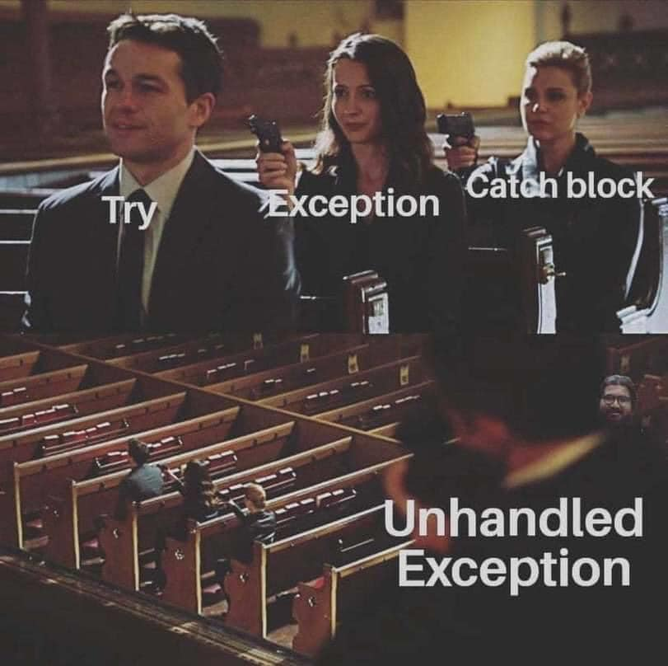
Exception handling
try
catch
finally

Slide 14
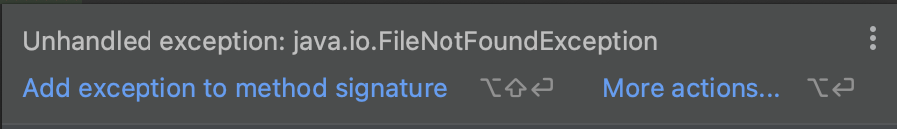
Exception handling
private static File loadFile(String filePath) throws FileNotFoundException {
throw new FileNotFoundException();
}
public static void main(String[] args) {
loadFile("path/to/file");
}

Slide 15
Exception handling
Type | How to recognize | Recommended for program to catch? | Is program required to catch or declare?
Runtime exception | Runtime exception or its subclasses | Yes | No
Checked exception | Exception or its sunglasses but not RuntimeException or its subclasses | Yes | Yes
Error | Error or its subclasses | No | No

Slide 16
Exception handling
public static void main(String[] args) {
try {
loadFile("path/to/file");
} catch (FileNotFoundException e) {
System.out.println("Cannot load file!");
} finally {
System.out.println("File load finished!");
}
}
The "try" keyword is used to specify a block where we should place an exception code. It means we can't use try block alone. The try block must be followed by either catch or finally.
The "catch" block is used to handle the exception. It must be preceded by try block which means we can't use catch block alone. It can be followed by finally block later.
The "finally" block is used to execute the necessary code of the program. It is executed whether an exception is handled or not.

Slide 17
Unreachable exception handler
private static File loadFile(String filePath) throws FileNotFoundException {
throw new FileNotFoundException();
}
public static void main(String[] args) {
try {
System.out.println("Print message to the console");
} catch (FileNotFoundException e) {
System.out.println("Cannot print message!");
}
}

Slide 18
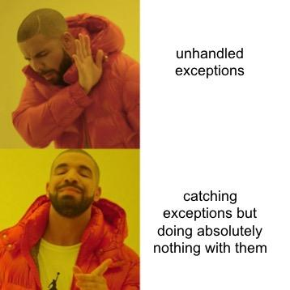
Exception catch blocks order
public static void main(String[] args) {
try {
loadFile("path/to/file");
} catch (FileNotFoundException e) {
System.out.println("Handle FileNotFoundException");
} catch (ClassCastException e) {
System.out.println("Handle ClassCastException");
} catch (Exception e) {
System.out.println("Handle Exception");
}
}

Slide 19
Using multi-catch
public static void main(String[] args) {
try {
loadFile("path/to/file");
} catch (FileNotFoundException e) {
System.out.println("Handle Exception");
} catch (ClassCastException e) {
System.out.println("Handle Exception");
}
}
public static void main(String[] args) {
try {
loadFile("path/to/file");
} catch (FileNotFoundException | ClassCastException e) {
System.out.println("Handle Exception");
}
}

Slide 20
Default exception handler
Prints out exception description;
Prints the stack-trace;
Causes the program to terminate.

Slide 21
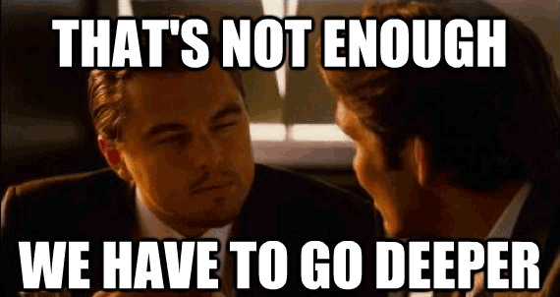
Stack trace

Slide 22
Assertion
An assertion is a boolean expression that you place at a point in your code where you expect something to be true
An assertion allows for detecting defects in the code
The syntax for an assert statement has two forms:
assert boolean_expression;
assert boolean_expression: "error_message";
Assertions are DISABLED by default

Slide 23
Assertion
public static void main(String[] args) {
int result = multiplyAll(0, 2, 3);
assert result > 0 : "Result should be positive";
}
private static int multiplyAll(int a, int b, int c) {
return a * b * c;
}
Exception in thread "main" java.lang.AssertionError: Result should be positive
at AssertionExample.main(AssertionExample.java:4)

Slide 24
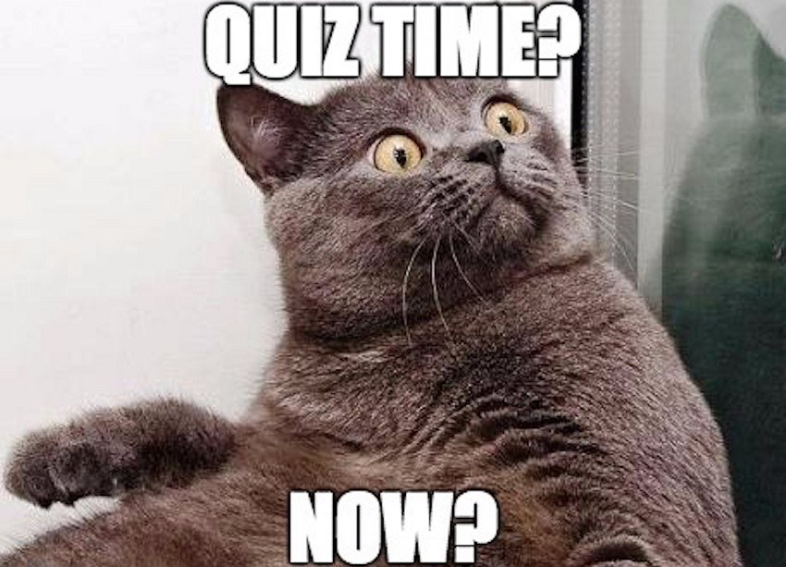
Quiz

Slide 25
public static void main(String[] args) {
try {
mightThrow();
} catch(FileNotFoundException | IllegalStateException e) {
e = new RuntimeException();
} catch(InputMismatchException e | MissingResourceException e) {
} catch(FileNotFoundException | IOException e) {
} catch(SQLException e){
} catch(FileNotFoundException | IllegalArgumentException e) {
} catch(Exception e) {
} catch(IOException e) {
}
}
private void mightThrow() throws DateParseException, IOException {…}
in multicatch block this variable is effectively final
extra variable name
different hierarchy
cannot catch SQLException because nothing can potentially throw one
cannot catch
more general superclasses must be caught after their subclasses
more general superclasses must be caught after their subclasses

Slide 26
private static void throwException() {
try {
throw new RuntimeException("First Exception");
} catch(RuntimeException e) {
throw new RuntimeException("Second Exception");
} finally {
throw new RuntimeException("Third Exception");
}
}
When an new exception is thrown in a catch block or finally block that will propagate out of that block, then the current exception will be aborted (and forgotten) as the new exception is propagated outward.

Slide 27

Homework
Write a garbage data validator that will follow business rules and save only valid user data in memory storage.
Handle all exceptions that may be thrown by an in-memory store.
Create a custom validation exception and use it.
Catch all exceptions that might appear in the system and wrap them in proper response objects.
Follow OOP rules in this homework
Follow clean code practices in this homework
DO NOT move or rename core module classes!
DO NOT move or rename classes with specific comment!

Slide 28
Homework business rules
User ID cannot be null
User ID must be unique
User email must be valid
User email cannot be null
User email cannot be empty
User email cannot contain spaces
User email cannot contain special characters such as (){}`_/\]['".
User email must be unique
Username cannot be null
Username cannot be empty

Slide 29
Homework business rules
Username must be one word
Username cannot contain special characters such as (){}`/\]['”
Username must be unique
Username must be in lowercase
User full name cannot be null
User full name cannot be empty
User full name must be two words separated by a space.
User full name must be written in camel case.
User full name must contain only letters
User age must be over 18 years.

Slide 30
Homework business rules
User age must be less then 100
User age cannot be null
User notes can be empty
User notes can be null
User notes cannot be longer than 255 symbols
Amount of user followers must be zero or bigger
Amount of user followers cannot be null

Slide 31
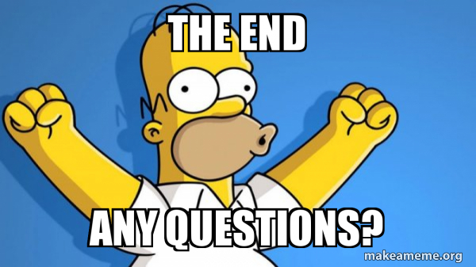
Questions & Answers

Slide 32
Literature
Java error model:
Baeldung
Exceptions (Oracle)
Books:
“Clean Code” by Robert Martin (up to 8)
“Java: The Complete Reference” by Herbert Schildt (chapter 10)

Slide 33
Thanks!
Find us in Slack:
@Bohdan Cherniak
@Vladyslav Nikolenko
@Volodymyr Vedula

